Slide 1

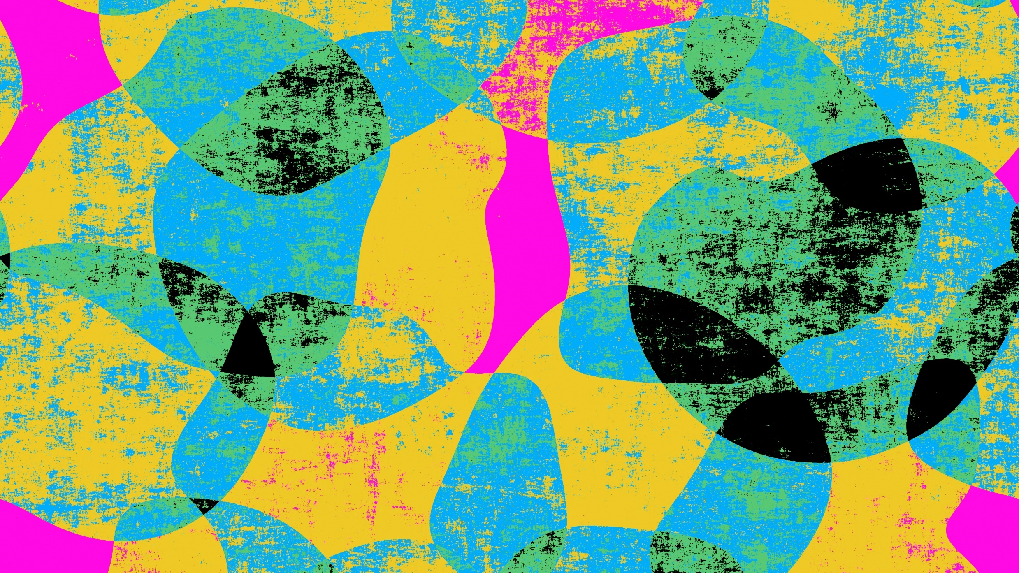
Pac-man
Supervised by: Dr. Hala Zayed

Slide 2
Team members
Ahmed Mostafa 202000896
Sara Mohamed 202001828
Habiba Yasser 202003004
Abdelrahman Akram 202000129

Slide 3

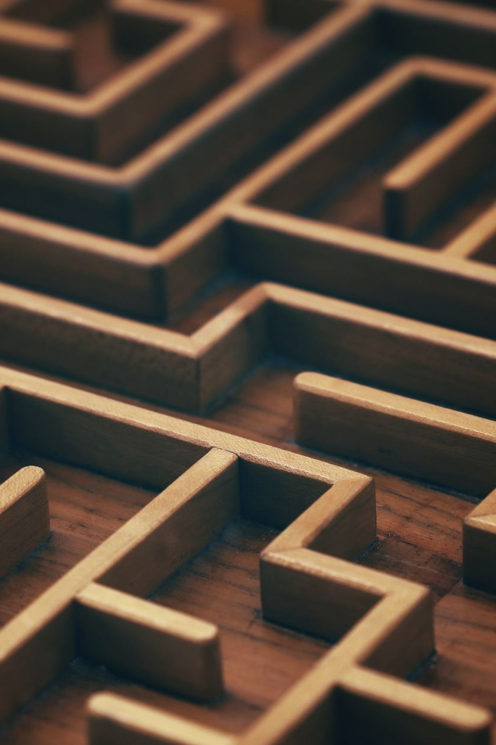
Introduction
The main idea of this game, Pac-man, is to assist in creating customizable random mazes and be able to work on that, like applying the different search algorithm with much ease.
The algorithms we used :
Breads first Search
Depth first search
A*
DijkstraMaze

Slide 4
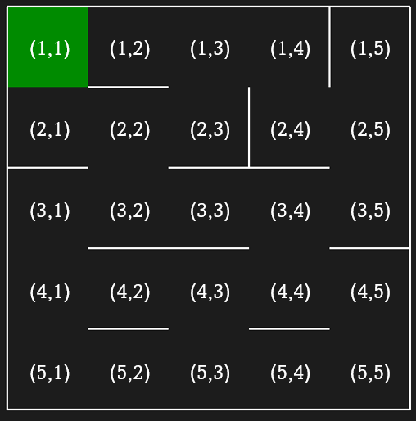
How the is maze designed?
the maze have two indices, one for row and the other for the column.
The top-left cell is the goal of the maze
all cells of the maze are accessible and there is one and only one path from any cell to the goal cell.

Slide 5
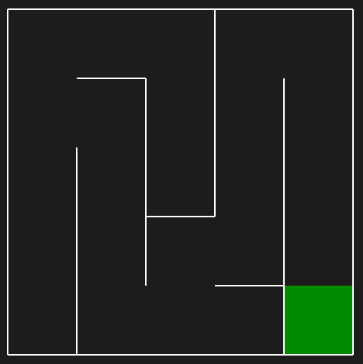
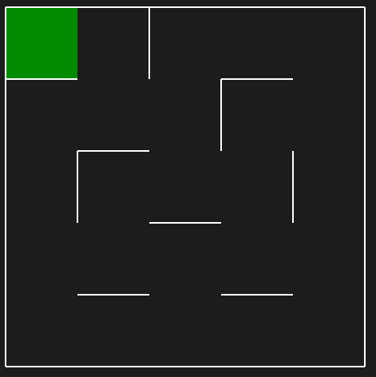
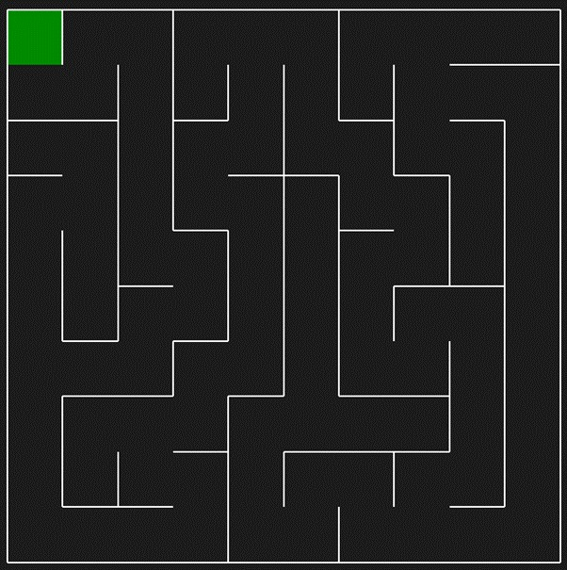
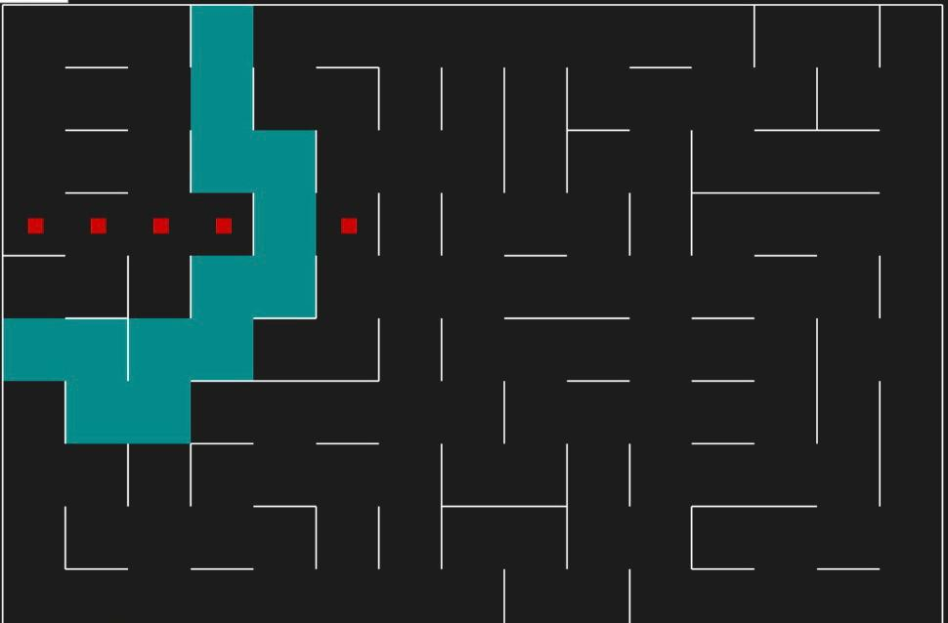
The mazes we used

Slide 6
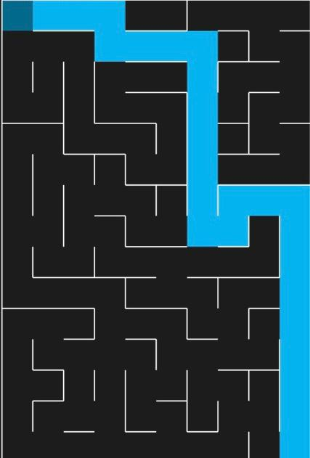
Breadth first search
BFS always returns the solution that Is closest to the initial point. It returns a full shortest path to the end point

Slide 7
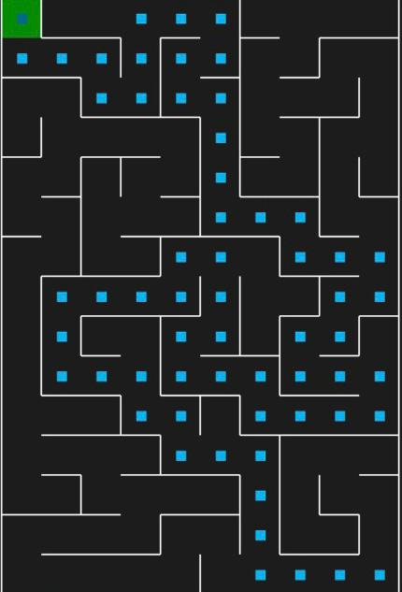
A* search
The A* algorithm is widely used in pathfinding and graph traversal. The system overall performance is acceptable and able to find the shortest path between two points

Slide 8
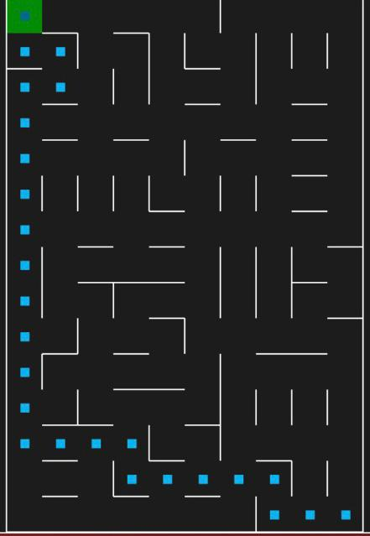
DFS
DFS is usually is not the best option when it comes to mazes as it will get the longest path , because dfs reaches each step in the maze .

Slide 9
DijkstraMaze
Dijkstra's algorithm is an algorithm for finding the shortest paths will assign some initial distance values and improve them step by step

Slide 10
Thank you

